Slide 1

The principles of effective communication
By Usman Basharat S1300173
P2-
Unit 1 – Communication and Employability Skills

Slide 2

What is communication?
A way of exchanging words and ideas through people. This could be one-to-one or within a group.
They are 3 types of communication for this to be successful:
General communication
Interpersonal communication
Written communication
By Usman Basharat S1300173
P2-
Unit 1 – Communication and Employability Skills

Slide 3
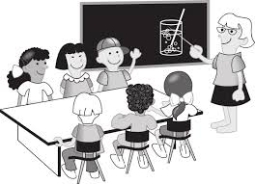
General Communication
For any communication to take place, there needs to be a audience listening to what you are saying. General communication can be talking to anyone. It says ‘general communication’.
It can be adapting an type of communication depending on which type of audience you have. The types of audience they can have is:
Depending on the age of the audience, you will have to change the tone and the words you use. This is because some words little children may not understand.
The type of communication can change to videos, written and images.
The cultural differences could be quite huge for general communication. For example if you have an interview and the employer is from Asia and the future employee is from Britain. They would talk differently, because they are brought up in different backgrounds. By doing this, you need to make sure that you don’t say anything that may offend anyone.
By Usman Basharat S1300173
P2-
Unit 1 – Communication and Employability Skills

Slide 4

Question and Answer
When someone asks a question to the presenter, you expect them to know the answer. If you don’t know the answer, it would look bad on the presenter because the audience would think they don’t know much about the topic.
Answers need to be clear and concise so that the audience can hear your voice.

Slide 5
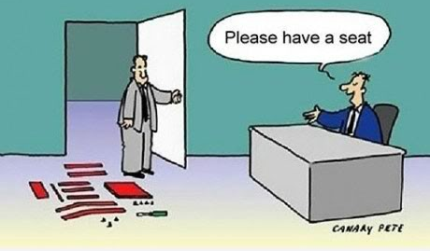

Interpersonal communication
By Usman Basharat S1300173
P2-
Unit 1 – Communication and Employability Skills
This is when you communicate with more than one person. This is important because you need to be successful at how you do this. For example, some techniques are always present your body language up straight and nod when the interviewer is speaking to show that you are listening. Also, you can smile when you are successful or given an compliment to show you are listening again. The tone of your voice is important because if you are shouting at the employer, he would think that you are some sort of aggressive person.

Slide 6
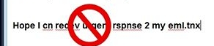

Written Communication
Written communication is a type of interaction that is in a written format. Proof-reading your work is always important. It detects errors in your work. If you always review your work, it would be perfect. If you don’t proof read your work, it’s most likely they will be a lot of mistakes. Also, it’s important when you are writing a letter you have correct spelling.
Another written communication could be capitalism. If you write in capitals in an email, it could come across as offensive to the receiver. It demonstrates that you are shouting at the receiver.
By Usman Basharat S1300173
P2-
Unit 1 – Communication and Employability Skills

